Slide 1
ProCalculator

Slide 2
Objectives
Performing calculations and bitwise operator on various base number
Visualizing how the number behaves in different base number
User-friendly through reusing the result from the previous calculations

Slide 3
Members & Task Allocation
Ng En Hao – Logics behind the calculator
Lim Jet Tin – Debugging and testing
Lois Lim Gui Jin – Formatting and paperwork

Slide 4

Problems
Lack of assembly knowledge that needed to complete assignment which are not taught in syllabus.
Hard to obtain useful materials from internet.
Understanding how to think with “CPU-brain”

Slide 5
Conclusion
Get used with dos command
Learn more assembly language knowledge which are out of syllabus.
Learn how does registers compute the functions that we use everyday

Slide 6
What we see:
13EE
What the assembly actually “see”:
‘1’, ‘3’, ‘E’, ‘E’, ‘13’

Slide 7
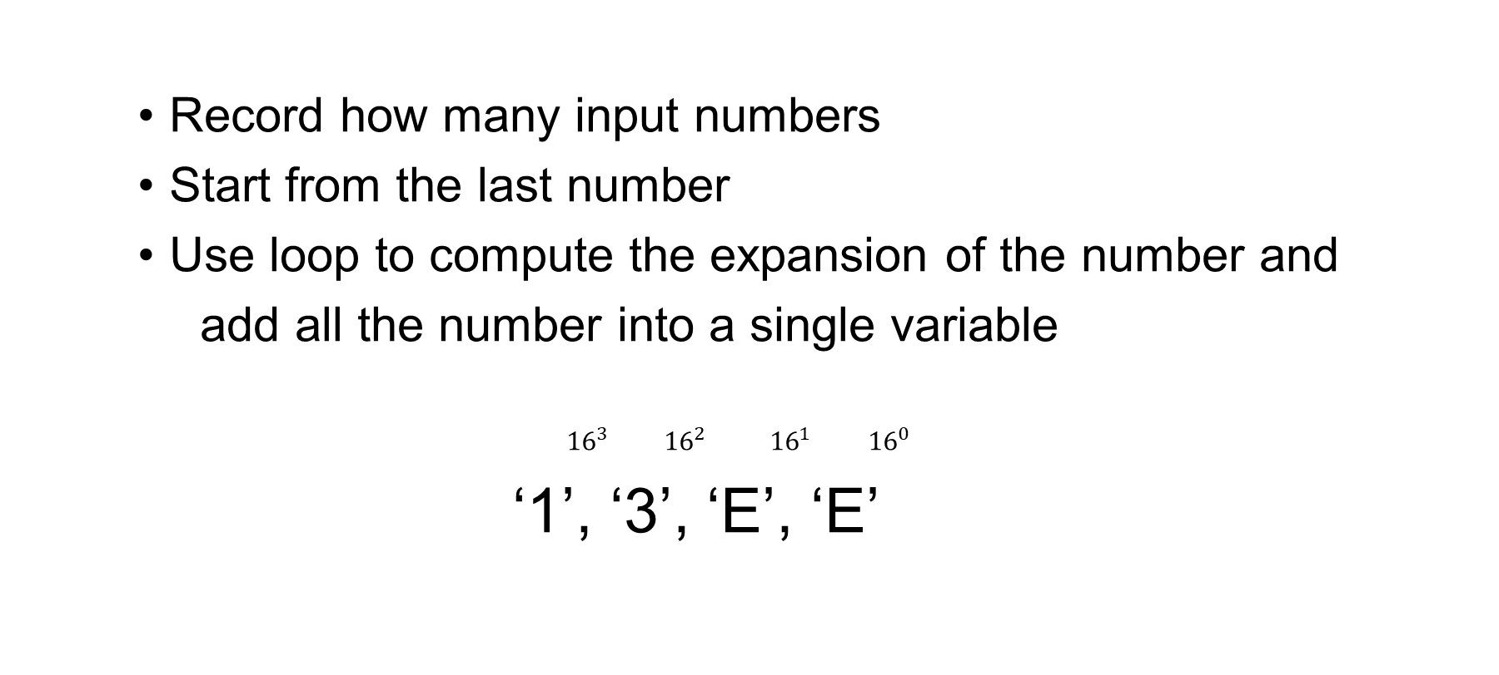
Record how many input numbers
Start from the last number
Use loop to compute the expansion of the number and
add all the number into a single variable
${16}^{3}$ ${16}^{2}$ ${16}^{1}$ ${16}^{0}$
‘1’, ‘3’, ‘E’, ‘E’

Slide 8
Numeric value in register: 13EE
Use division to convert the numeric value to string
Store quotient in output array, and store the remainder to be used in next loop

Slide 9

${13EE}_{16}$ divide ${1000}_{16}$
Quotient: 1 Remainder: ${3EE}_{16}$
array: ‘1’ ${1000}_{16}$ → ${100}_{16}$
${3EE}_{16}$ divide ${100}_{16}$
Quotient: 3 Remainder: ${EE}_{16}$
array: ‘1’, ‘3’ ${100}_{16}$ → ${10}_{16}$
$⋮$

